Slide 1
Online Public Input
Open from Oct. 6 through Oct. 14
360 responses

Slide 2
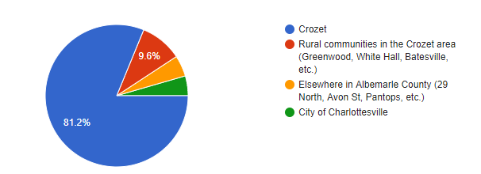
Where do you live?

Slide 3
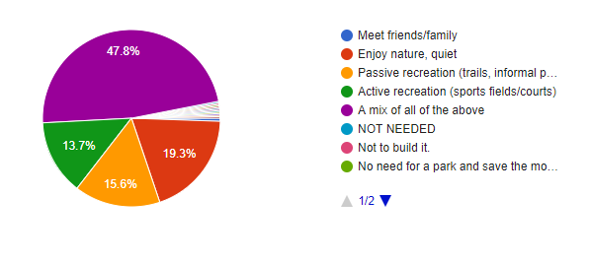
My vision for the Western Park is a place to:

Slide 4
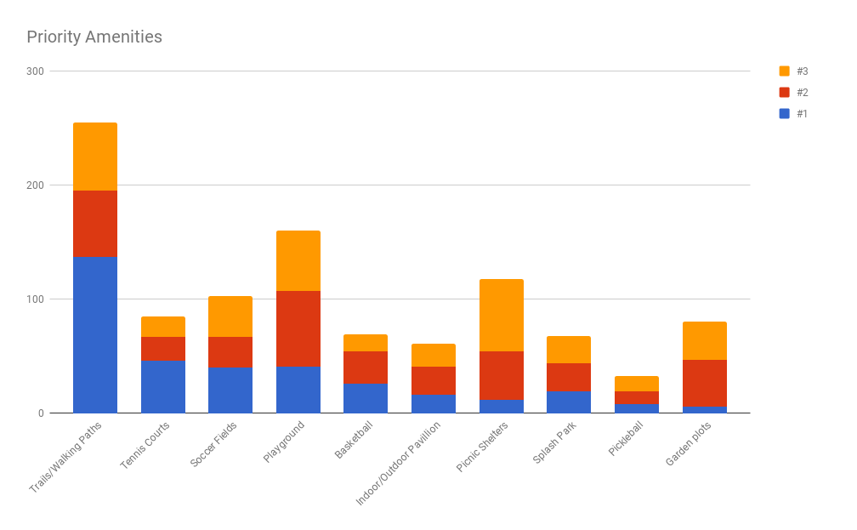

Slide 5
Top Amenities
Trails/Walking Paths
Playground Equipment
Picnic Shelters
Soccer fields
Garden Plots

Slide 6
Write-In
Natural (no development) | 14
Dog park | 11
Picnic area | 7
Baseball | 6
Stage | 6
Bike Trail | 5
Par course | 5
Parking | 5
Pickleball | 5
Trails | 5
Disc golf | 4
Restrooms | 4
Splash park | 4
Athletic fields | 3
Playground | 3
Soccer | 3
Water feature | 3
Basketball | 2
Drinking fountain | 2
Garden plots | 2
Interpretive signage | 2
Tennis courts | 2
ADA | 1
Benches | 1
Bird sanctuary | 1
English gardens | 1
Family friendly | 1
Indoor recreation | 1
Park | 1
Passive | 1
Pavillion | 1
Pool | 1
Quiet | 1
Teens | 1
Volleyball courts | 1
Wifi | 1

